Slide 1

GOAL SETTING Meeting - 2025

Slide 2
Objective of Goal Setting Meeting
Goal Alignment:
Vice Chairman
Create transparency and alignment behind Divisional/Functional strategic priorities.
Enable employees to see a direct link between individual goals and Division/ Functional strategic objectives.
Reinforce what high performance looks like for the team.
Clarify what great will look like and what metrics will be followed.
Help employees focus on team goals, coordinate work with peers & understand interdependencies to achieve goals.
Help employees create SMART Goals and put goals on People Hub.
Division/Function Leadership
Department heads
People Managers
Individual Contributors

Slide 3
Meeting Agenda

Slide 4
Meeting Agenda|
 | Agenda Item | Description | Time ( to be modified) | Speaker
1. | Introduction | Welcome and share the key objectives and desired outcome of the meeting | 1:00 PM-1:15 PM
2. | Overview of Divisional/Functional strategic priorities | Provide a brief summary of the Divisional/Functional strategic priorities for the year and the business unit/teams’ key priorities | 1:15Pm-1:30 PM
3. | Q&A Divisional/Functional strategic priorities | Invite questions on the information shared. | 1:30 PM- 1:45 PM
4. | Team Priorities & Opportunities | Team discusses together how will those deliverables get broken down into accountabilities…will there be any collaborative team deliverables…and who will be responsible for what. | 1:45 PM- 2:15PM
5. | Guidance on Employee Goal-Setting | Guide the employees on how to set individual SMART goals for the year ensuring that the goals clearly contribute to team and Divisional/Functional strategic priorities. | 2:15PM- 2:30 PM
6. | Goal Setting | Start Goal setting activity where team members starts drafting their goals & discussing have their peers | 2:30 PM- 2:45 PM
7. | System | Share with attendees how to navigate the system & give sometime to attendees to log their goals on the system & share if the have any challenge | 2:45 Pm- 2:55 PM
8. | Wrap up | Summarize the meeting points & discuss next steps | 2:55 PM– 3:00 PM

Slide 5
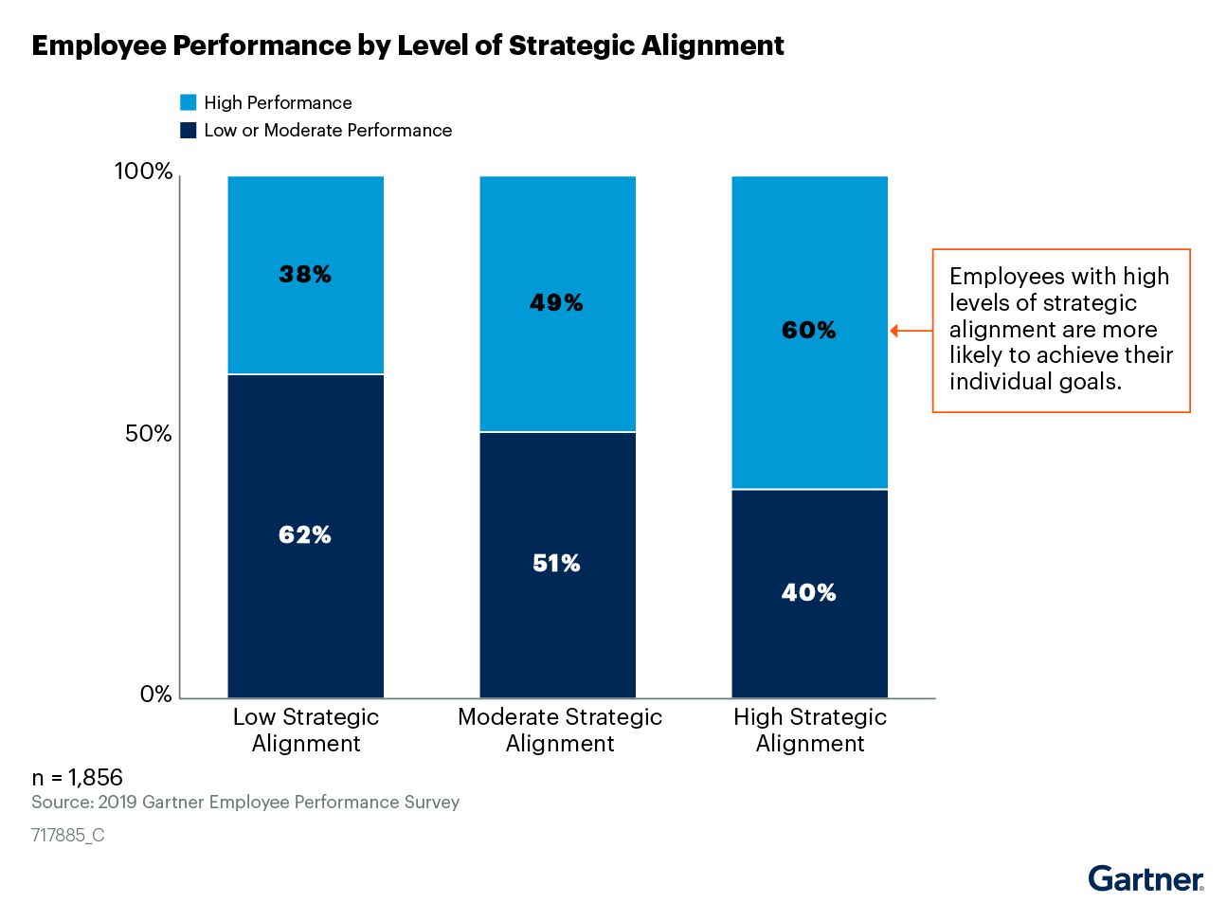
Purpose of Goal Setting
Provides a clear line of sight, connecting individual contribution to overall business results. Clarifies the expectations
As an individual
Or as part of a team
Ensures that individual goals are aligned, and that cumulatively they deliver on the expectations of the team, unit and division.

Slide 6
Divisional/Functional Strategic Priorities
Divisional/Functional Strategic Priorities

Slide 7
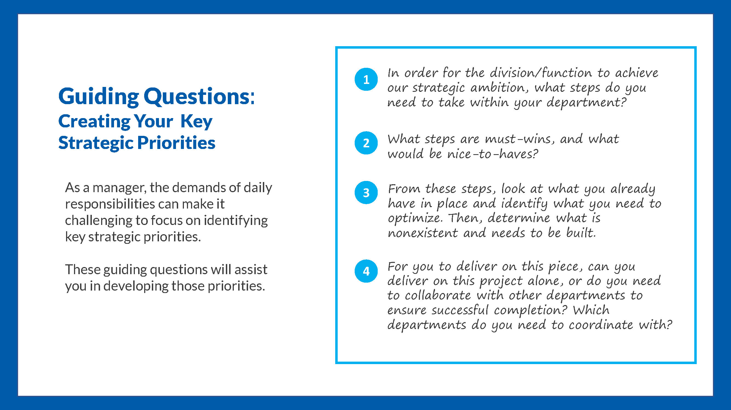

Slide 8
2025 Priorities & Opportunities- Handout to be distributed
Priorities & Opportunities Sheet
Individual Priorities
Priority 1 | 1. ………………………………….... 2. …………………………………....
Priority 2 | 1. ………………………………….... 2. …………………………………....
Priority 3 | 1. ………………………………….... 2. …………………………………....
Priorities that need to be owned by the full team | Opportunities to collaborate with different peers.
1. ………………………………….... 2. ………………………………….... | 1. ………………………………….... 2. …………………………………....

Slide 9
Setting SMART GOALS
Ensuring clarity around the objective set.
Ask yourself, “if someone outside of my team read this objective, would they understand what I aim to achieve”.
S
SPECIFIC
M
MEASURABLE
Defining the metric to assess success.
The more this is spelt out, the more objective one can be during the year end evaluation. The measure can be both quantitative or qualitative. Ideally it also defines the permissible margin of deviation.
A
Ensure the goals are challenging and provide a stretch beyond the regular everyday work.
Ensure that the right tools, capabilities and knowledge are in place to deliver on the objective.
ACHIEVABLE
R
RELEVANT
Does it tie into the strategic priorities of your business
T
Specify a date or amount of time when the goal must be completed
TIME-BOUND

Slide 10
Al-Futtaim Balanced Score Card (BSC)
Instructions: Meeting owner to explain how BSC translated into Divisional/Functional goals & how Al-Futtaim use this to measure the performance of its employees and provides clarity and transparency to those employees and businesses in order for them to develop in their own roles and contribute to the progress of the organisation.
It is recommended that the number of goals should be between 3-6 for each individual and that no goal holds less than 10% weighting. The weight of each goal should be indicative of the amount of effort and work required to deliver on that goal. The sum total of the goals should add up to 100%.
04. FINANCIAL
01. MARKET
KPIs of how well Al-Futtaim is performing financially, including revenue, profitability and expenses.
Al-Futtaim’s performance in the context of the external or internal market; this includes customers, suppliers and principals
AL-FUTTAIM VALUES
LEADERSHIP COMPETENCIES
03. BUSINESS EXCELLENCE
02. PEOPLE
The internal processes Al-Futtaim uses to get the work done. making sure we optimise performance efficiency & effectiveness. Can also include major projects
Al-Futtaim performance on people metrics engagement, succession planning, Emiratisation.
BSC enables measurement of business performance across four quadrants:
Notes:
This is how the BSC is built if you have a goal falls under this.

Slide 11
Setting SMART and Aligned Goals
Setting SMART GOALS
Example: My goal is to increase student and parent engagement in the next 6 months by 5% by running surveys every 2 months and working on the feedback received. The results will be relayed to the management team after every survey with clear ouline of actions taken on previous feedback.
SPECIFIC
Does the goal clearly define expectations in terms of actions and outcomes? What exactly will be done/delivered/actioned?
What is the outcome expected?
What would great look like, and how will it be measured?
Does the goal define specific metrics (quantity, quality, cost, etc.) that can be objectively measured? & what data source will be utilised to gain the information?
MEASURABLE
ACHIEVABLE
Is the goal challenging but reasonable?
Does the employee have the skills and experiences necessary to achieve the goal?
Is achievement of the goal within the employee’s control?
Can the employee reasonably be expected to successfully complete the number of goals assigned?
What might need to beput in place to enhance likelihood of success?
Is the scope of the goals appropriate given the employee’s job responsibilities and level?
Does the goal clearly connect to divisional and/or function goals?
Does the employee understand how his/her goal contributes to the company’s goals?
RELEVANT
TIME-BOUND
Does this goal need to be delivered at a specific timing, or will it run throughout the year?

Slide 12


Slide 13
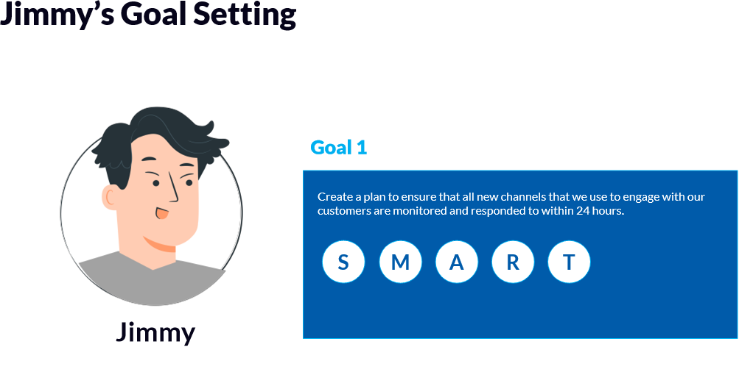

Slide 14
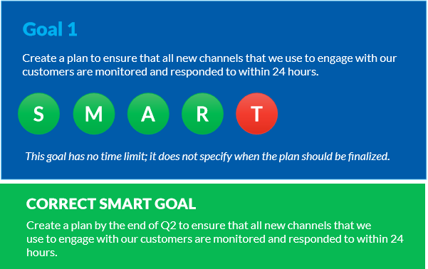

Slide 15
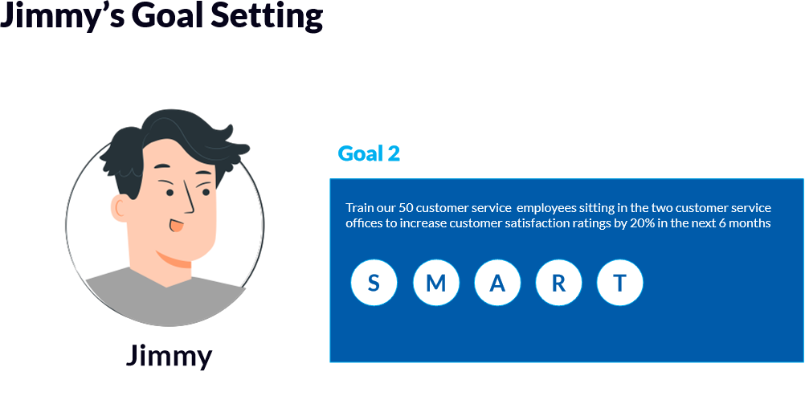

Slide 16
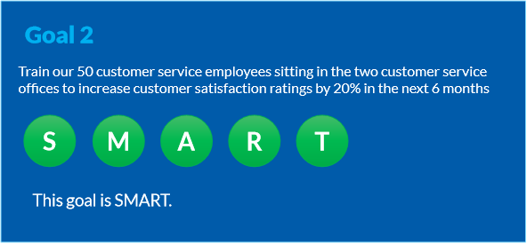

Slide 17


Slide 18
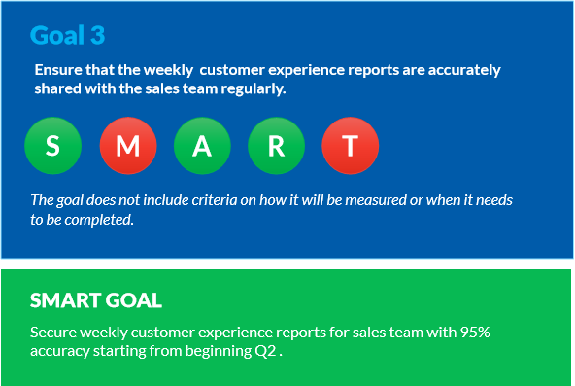

Slide 19
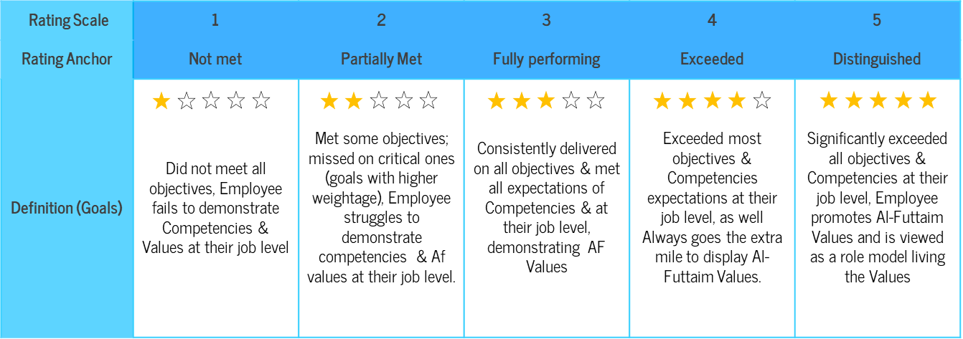
Identify Success Measures for Your Goals
Instructions: HRBP to explain to attendees what are the success measures they need to consider while setting goals. Ask the attendees to Reflect on the questions below to identify how measures of success can be added to your goals at fully performing, exceeded and distinguished levels.
What does high performance look like in delivering your individual goals?
How will the goals be measured? What will ‘Fully performing’ look like?
What will ‘exceeded’ and ‘distinguished’ look like?
Achieving a ‘meets’ level, in aggregate, should be equivalent to the business unit or function successfully delivering its stretch business goals.

Slide 20
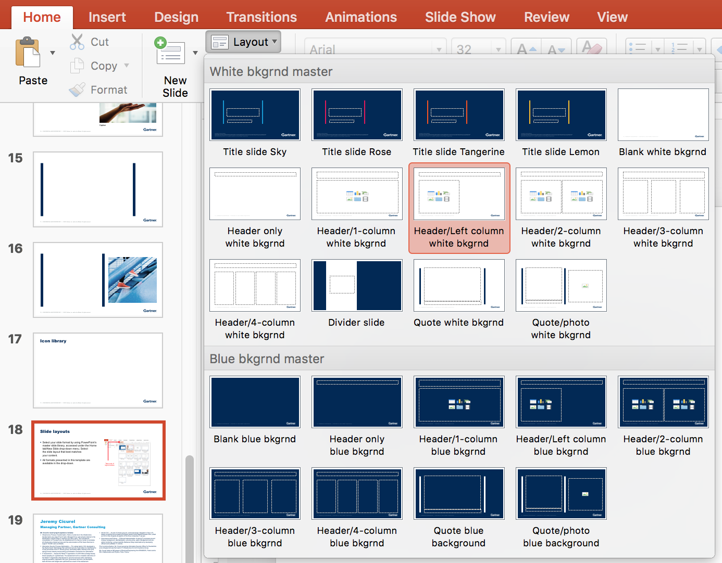
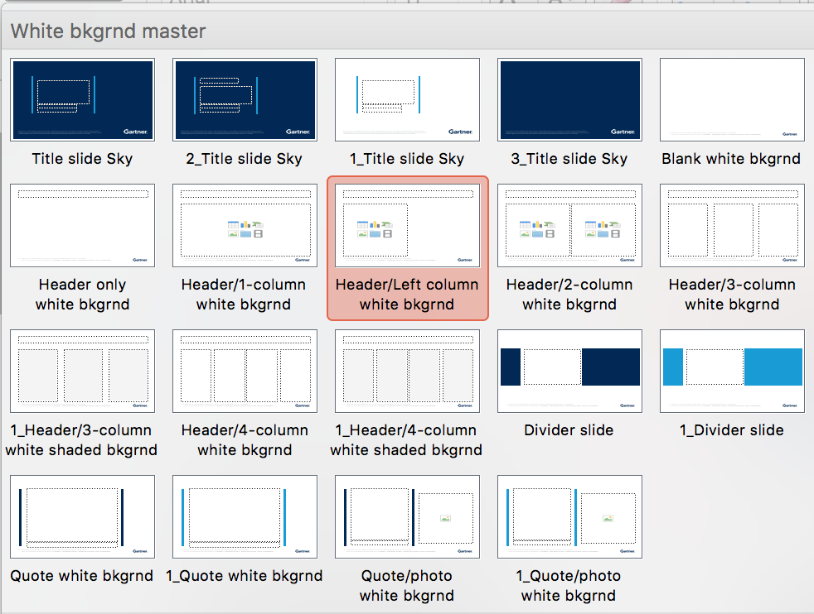

Time To Set Your Individual Goals Setting
Instructions: Activity 3: (15 min): Requesting attendees to think of top 2 goals they need to develop ensuring they added KPI for each goals.
Individual SMART Goals | Success Measures
#Goal 1:
#Goal 2:
Before you develop your goals:
Ensure goals are aligned to divisional/functional goals.
Ensure all interdependencies have been identified .
Validate that measures selected are an indication of success in your goal.
Check that your individual goals are adding up to the team ambition

Slide 21
Peer Goal Sharing- Handout to be distributed
Sample questions peers can use for providing feedback on individual goals
Are you working on the right goals to deliver your “piece of the puzzle” for our Division/Function goals?
Are these goals within your sphere of influence? If no, what are the interdependences?
Are your goals ambitious enough?
Have you identified what help you need from your team and peers to achieve your goals?
What are the risks to delivery of your goal? What steps will you take to mitigate the risk?

Slide 22




Peer Goal Sharing
Demonstrate how peers can challenge goals
Employee goal refinement
Collective teasing of goals
Collaboration mapping
Employee to share with peer their two goals & peer start using the questions in slide 21 to challenge the developed goals.
Employee refine goals based on peer feedback & switch roles & repeat activity
Employee starts mapping out who they need to collaborate with to achieve their individual goals
Team regroup. Volunteer start sharing individual goals with the entire team to collectively test with the HRBP & meeting owner and ensure successful output from activity. (preferable 4-5 volunteers)

Slide 23
Conclusion and Next Steps for Employees
Reach out to your peers in your team or other teams to discuss collaboration plans (if you are dependent on them for achieving your goals) and resolve conflicts (if any).
Schedule 1:1 with your direct manager in order to algin on individual goals & discuss any challenges and support needed.
Complete your goals and put them on People Hub by <dd/mm/yyyy>.
Reach out to your manager or HRBP <insert name and email of HRBP> for any support on the goal-setting process.

Slide 24
SYSTEM NAVIGATION

Slide 25

Thank you for your time!
Any questions?

